Slide 1
IoT + Smart Contracts(Eth)
Blockchain Tech Research Group @MPCR
Contributors: Océane Boulais (looking for others!)
gitHub: tba
Meets: 530-730p, Wednesdays @MPCR lab

Slide 2
high-level objectives
low-level HW implementation (RPi, sensors etc)
secure data storage (blockchain)
integrative nodes (smart contract design)
GUI user interface to visualize data (from the ethereum client)
Notes:
Recent death of eleven senior citizens at a local nursing home in the aftermath of hurricane Irma.
The nursing home overheated due to a power outage and, supposedly, instead of calling 911 when residents became ill, the nursing staff was unable to meet the needs of their patients, and ultimately, lives were lost. There was a discrepancy between 911 response records and the nursing home staff, who claimed they had called 911. If there had been an array of temperature sensors arming a controller with event triggers (defined by a smart contract), after reaching a certain temperature threshold, a call could’ve been made to emergency responders independent of human negligence. Furthermore, all reactive temperature data and corresponding actions would have been recorded to a secure ledger that could have later been audited.
Build a service w/ data node fleets

Slide 3
project motivation/objectives
auditing – post-Irma nursing home
secure data storage (block)
automated ”transactions” (data recording) amongst many nodes (temp sensors, e.g)
transparent interface
Notes:
Recent death of eleven senior citizens at a local nursing home in the aftermath of hurricane Irma.
The nursing home overheated due to a power outage and, supposedly, instead of calling 911 when residents became ill, the nursing staff was unable to meet the needs of their patients, and ultimately, lives were lost. There was a discrepancy between 911 response records and the nursing home staff, who claimed they had called 911. If there had been an array of temperature sensors arming a controller with event triggers (defined by a smart contract), after reaching a certain temperature threshold, a call could’ve been made to emergency responders independent of human negligence. Furthermore, all reactive temperature data and corresponding actions would have been recorded to a secure ledger that could have later been audited.
Build a service w/ data node fleets

Slide 4
ETH + blockchain + smart contracts 101

Slide 5
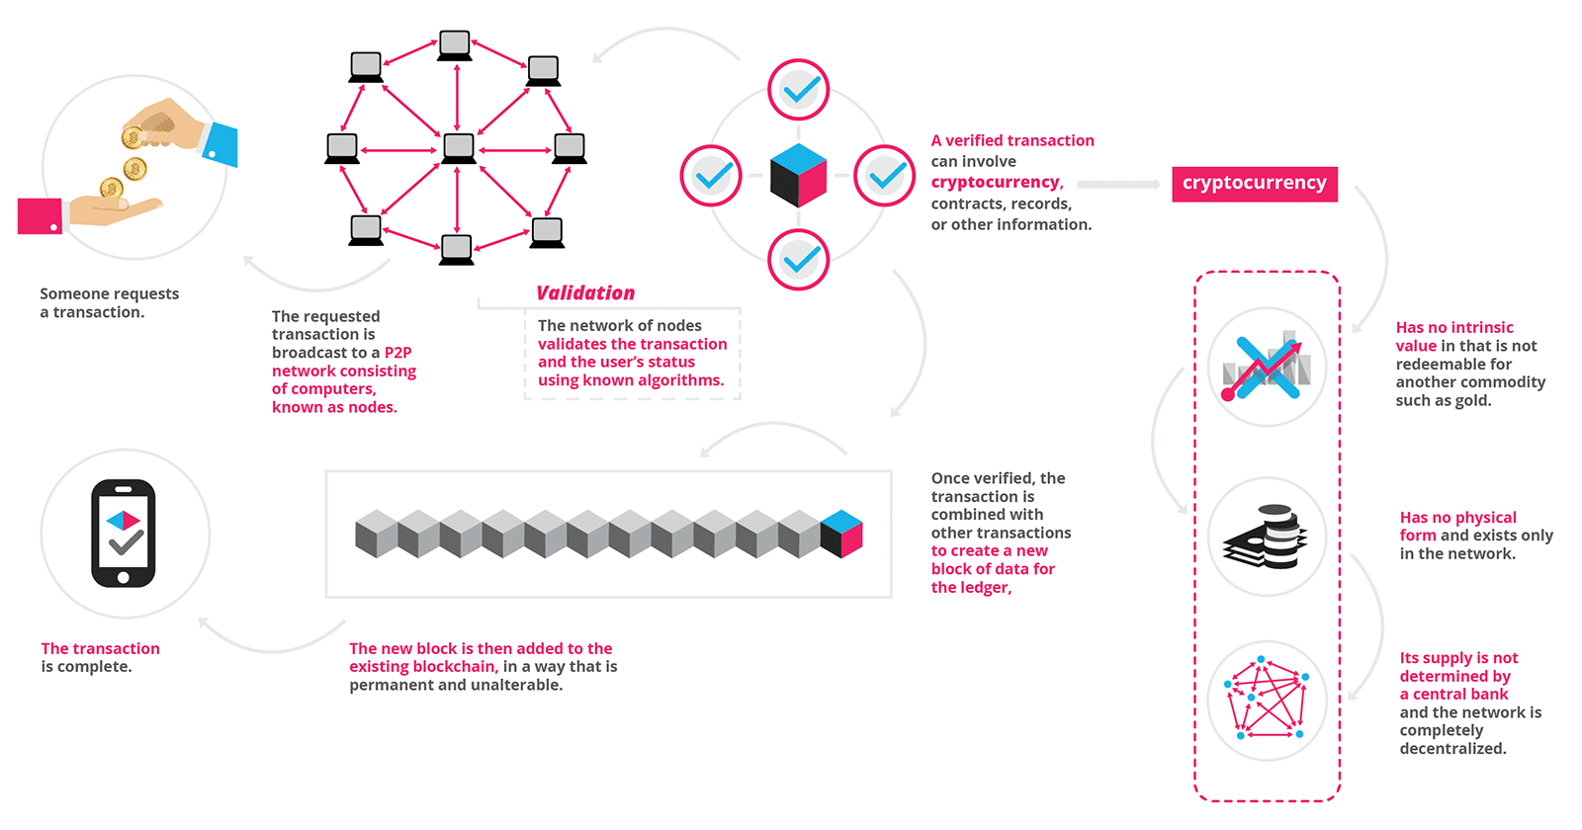
blockchain

Slide 6
ethereum
ethereum aims to function both as a kind of decentralized internet and a decentralized app store (we’ll be making a Dapp)
One ether or ETC = $1,121.17 USD (as of 1.27.18)
EVM (Ethereum Virtual Machine) is an environment where arbitrary code of smart contracts and other operations can be executed.
All transactions, from simple transfers to ICO smart contracts, require some amount of operations to perform. operations has an associated cost in gas.
difference operations require more or less gas
ie operation if(var > 1) may cost 1 gas, but a more complex operation (smart contract pay out) could cost 100 gas
https://ethgasstation.info/

Slide 7
smart contracts
not new…First conceived in 1993, the idea was originally described by computer scientist and cryptographer Nick Szabo as a digital vending machine
Coded in the Turing-complete language, Solidity
Once the code is written, it is uploaded on the EVM- Ethereum Virtual Machine
Developers can create applications that run on the EVM using friendly programming languages modelled on existing languages like JavaScript and Python.

Slide 8
IoT + blockchain
configure RPi3 as an ethereum node
http://chainskills.com/2017/02/24/create-a-private-ethereum-blockchain-with-iot-devices-16/
Once Ethereum is installed on the RPi its able to synchronise with the live chain (mainnet)
The blockchain data (chaindata) is located at ~/.ethereum/chaindata
Accounts will be stored in a wallet located in this folder: ~/.ethereum/keystore

Slide 9
rough timeline
Feb 7 – set up RPi Ethereum nodes
Feb 4 - smart contract for data exchange
March 15 – OURI Funding Packet Due
Conferences, hackathons, more hardware
March 26 – (Poster) Ext Abstract Due: EU Conference on Networks & Communications
June 18-21, 2018
Ljubljana, Slovenia
2018 Mar. 23 – Deadline for submission of Travel Grant applications

Slide 10
deliverables/anticipated outcomes
network of communicating nodes (RPi) on the ethereum blockchain
built like an API layer for current implementations of data-collecting sensors
(2) main smart contracts (for now)
define how each node in the network publishes data to the blockchain (physical parameters, etc)
define how each node ”confirms” & secures the data written previously
are nodes the miners?

